Slide 1
Laboratory 1
User Centred Design
Group 10
Pedro Silva, 76066
Miguel Cruz, 76102
Inês Santos, 76334
How are the users

Slide 2
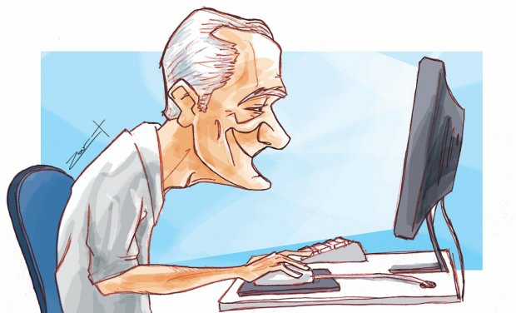
Identification of stakeholders 1/2
Users
Elderly
Nursing Institutions
Teachers
Developer Team
Webmaster
Teachers
Test Team
Satellites
Family
Friends
Nursing Institutions
Companies/Institutions

Slide 3

Identification of stakeholders 2/2
Legislators
Scientific and Pedagogic Departments
Financial Managers
Managers
Webmaster/manager
Maintenance Team
Marketers
Entertainment/Marketing companies
Social Network
Users
Satellites
Bank
Virtual or physical financial institutions

Slide 4
Description of the users profiles 1/2
Profile Characteristics | Elderly Technophobe | Elderly Committed | Elderly Experienced
Interest | few | some/a lot | a lot
Dynamic | few | some | a lot
Experience in online curses | none/few | few/some | a lot
Dependency | a lot | few/some | none/few
Technological knowledge | none/few | some | a lot

Slide 5
Description of the users profiles 2/2
Profile Characteristics | Inexperienced teacher in online curses | Experienced teacher in online curses
Responsibility | responsible | responsible
Certification | yes/no | yes/no
Teaching experience | few/some | a lot
Technological knowledge | few/some | some/a lot

Slide 6
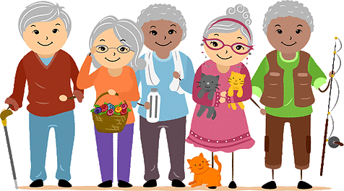
Monitoring Group
6 elderlies, with none, few or some experience in the technological knowledge, covering the three profiles described early.
2 or 3 employees of nursing institutions.

